Slide 1

Lecture 3
Chartering Projects & scope
Notes:
Key Learnings (Purpose of this slide)
To introduce the deck.
Presenter Notes
References
n/a

Slide 2

Question for you!
What are two things you learned from Project Selection and Prioritization?
Notes:
Key Learnings (Purpose of this slide)
To engage participants in the content of this chapter.
Presenter Notes
References
Arpan Bhatia/Shutterstock.com

Slide 3
Learning Objectives (1 of 2)
5.1 Understand the importance of scope management for project success.
5.2 Understand how conceptual development serves as a critical first stage in scope management.
5.3 Identify the steps in developing the scope statement.
5.4 Identify the elements in the work authorization phase of scope development.

Slide 4
Learning Objectives (2 of 2)
5.5 Identify the various types of information available for scope reporting.
5.6 Demonstrate how control systems and configuration management relate to scope development.
5.7 Discuss why effective scope management includes a project closeout stage.
5.8 Understand how project practices can support the critical goal of sustainability.

Slide 5
P M B o K Core Concepts
Project Management Body of Knowledge (P M B o K) covered in this chapter includes:
Develop Project Charter (P M B o K 4.1)
Plan Scope Management (P M B o K 5.1)
Collect Requirements (P M B o K 5.2)
Define Scope (P M B o K 5.3)
Create W B S (P M B o K 5.4)
Validate Scope (P M B o K 5.5)
Control Scope (P M B o K 5.6)

Slide 6
Project Scope
Project scope is everything about a project—work content as well as expected outcomes.
Scope management is the function of controlling a project in terms of its goals and objectives and consists of:
Conceptual development
Scope statement
Work authorization
Scope reporting
Control systems
Project closeout

Slide 7
Conceptual Development
The process that addresses project objectives by finding the best ways to meet them.
Key steps in information development:
Problem or need statement
Requirements gathering
Information gathering
Constraints
Alternative analysis
Project objectives
Business case
Project charter

Slide 8
Statement of Work (S O W)
A S O W is a detailed narrative description of the work required for a project.
Effective S O W s contain:
Introduction and background
Technical description of the project
Timeline and milestones

Slide 9
Statement of Work Components
Background
Objectives
Scope
Task or Requirements
Selection Criteria
Deliverables or Delivery Schedule
Security
Place of Performance
Period of Performance

Slide 10
Project Charter
Many organizations establish the project charter after the S O W.
A document issued by the project initiator or sponsor formally sanctioning existence of the project and authorizes the project manager to begin applying organizational resources to project activities.
Is created once project sponsors have done their “homework” to verify that:
there is a business case for the project
elements of project are understood
company-specific information for the project has been applied
It demonstrates formal company approval of the project.

Slide 11
Scope Statement
Establish project goal criteria to include:
a. cost
b. schedule
c. performance
d. deliverables
e. review and approval “gates”
Develop management plan for project
Establish a Work Breakdown Structure
Create a scope baseline

Slide 12
Work Breakdown Structure (W B S)
The W B S is a hierarchical decomposition of the total scope of work to be carried out by the project team to accomplish the project objectives and create the project deliverables. Each deliverable is decomposed, or broken down, into specific “bite-sized” pieces representing work to be completed.

Slide 13
Work Breakdown Structure Purpose
W B S serves six main purposes:
Echoes project objectives
Organization chart for the project
Creates logic for tracking costs, schedule, and performance specifications
Communicates project status
Improves project communication
Demonstrates control structure

Slide 14
W B S Hierarchy
The logic of hierarchy for the W B S follows this form:
Level | W B S Term | Description
Level 1 (Highest) | Project | The overall project under development
Level 2 | Deliverable | The major project components
Level 3 | Subdeliverable | Supporting deliverables
Level 4 (Lowest) | Work package | Individual project activities

Slide 15
Defining a Work Package
Lowest level in W B S
Deliverable result
One owner
Miniature projects
Milestones
Fits organization
Trackable

Slide 16
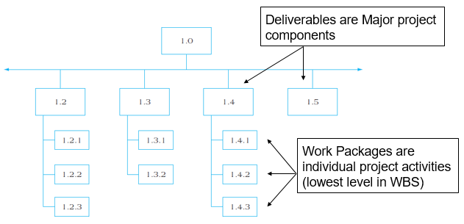
Figure 5.3 Partial Work Breakdown Structure

Slide 17
Question for you !
Consider the case of a large urban hospital that has made the decision to introduce an organization-wide information technology (IT) system for
billing, accounts receivable, patient record keeping, personnel supervision, and medical process control. The first step in launching this large installation project is to identify the important elements in introducing the technology. Can you identify the deliverables to install a new information system for an organization

Slide 18
Example of tasks
1. Match IT to organisational tasks and problems.
2. Identify IT user needs.
3. Prepare an informal proposal to present to top management (or other decision makers) for IT acquisition.
4. Seek and hire an IT consultant.
5. Seek staff and departmental support for the IT.
6. Identify the most appropriate location within the organization for the IT hardware to be located.
7. Prepare a formal proposal for IT introduction.
8. Undertake a request for proposals (RFPs) from IT vendors.
9

Slide 19
Example of tasks
9. Conduct a pilot project or a series of pilot projects using different IT options.
10. Enter a contract for purchase.
11. Adopt and use IT technology.

Slide 20
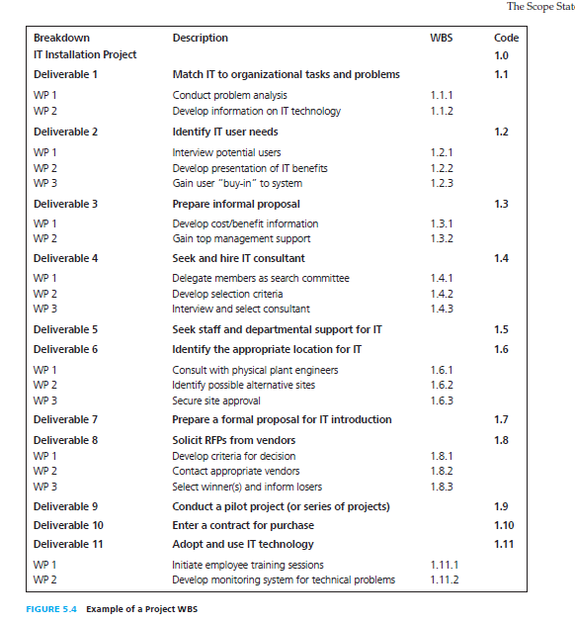
Example of WBS

Slide 21
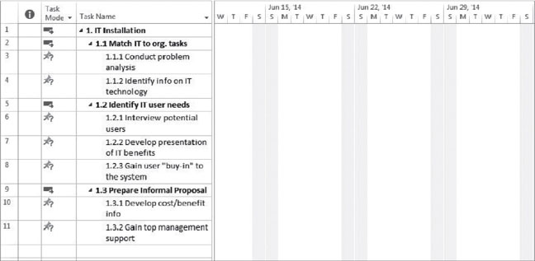
Figure 5.6 Sample W B S Development Using M S Project

Slide 22
Organizational Breakdown Structure
Organizational Breakdown Structure (O B S) allows
work definition
owner assignment of work packages
budget assignment to departments
O B S links cost, activity, and responsibility.

Slide 23
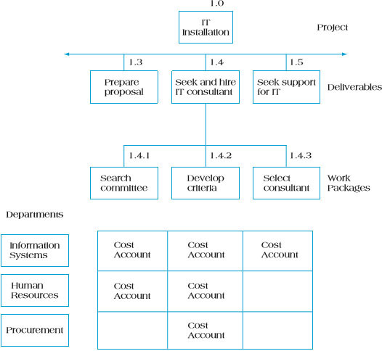
Figure 5.7 The Intersection of the W B S and O B S

Slide 24
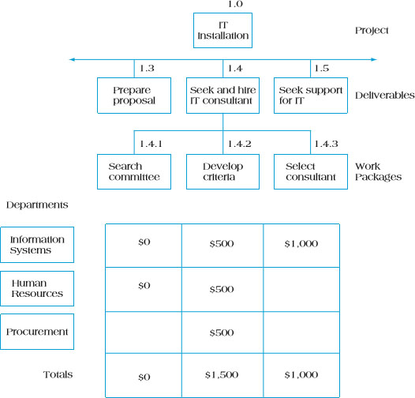
Figure 5.9 Cost Account Rollup Using O B S

Slide 25
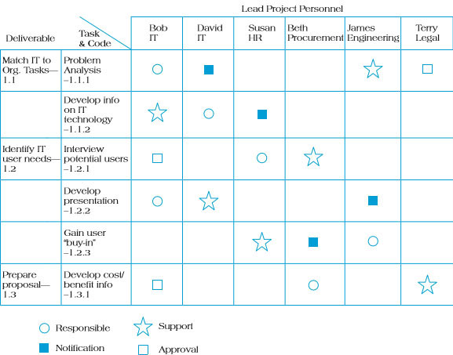
Figure 5.10 Responsibility Assignment Matrix

Slide 26
Defining a Project Work Package
Work package forms lowest level in W B S.
Work package has a deliverable result.
Work package has one owner.
Work package may be considered by its owner as a project in itself.
Work package may include several milestones.
Work package should fit organizational procedures and culture.
The optimal size of a work package may be expressed in terms on labor hours, calendar time, cost, reporting period, and risks.

Slide 27

Work Authorization
The formal “go ahead” to begin work.
Contractual documentation possesses some key identifiable features:
Contractual requirements
Valid consideration
Contracted terms
Contracts range from:

Slide 28
Scope Reporting
Determines what types of information reported, who receives copies, and when and how information is acquired and disseminated.
Typical project reports contain:
Cost status
Schedule status
Technical performance status

Slide 29
Reasons Why Projects Fail
Politics
Naïve promises
Naïve optimism of youth
Startup mentality of fledgling entrepreneurial companies
“Marine Corps” mentality
Intense competition caused by globalization
Intense competition caused by appearance of new technologies
Intense pressure caused by unexpected government regulations
Unexpected and/or unplanned crises

Slide 30
Types of Control Systems
Configuration control
Design control
Trend monitoring
Document control
Acquisition control
Specification control

Slide 31
Type of control systems
• Configuration management is defined as: A collection of formal documented procedures used to apply technical and administrative direction and surveillance to: identify and document the functional and physical characteristics of a product, result, service, or component; control any changes to such characteristics; record and report each change and its implementation status; and support the audit of the products, results, or components to verify conformance to requirements.
Baseline is defined as:
The project’s scope fixed at a specific point in time—for example, the project’s scheduled start date.

Slide 32
Type of control system
• Design control relates to systems for monitoring the project’s scope, schedule, and costs during the design stage. Chrysler developed Platform Design Teams (PDTs) composed of members from functional departments to ensure that new automobile designs could be immediately evaluated by experts in engineering, production, and marketing.
• Trend monitoring is the process of tracking the estimated costs, schedules, and resources needed against those planned. Trend monitoring shows significant deviations from norms for any of these important project metrics.
• Document control ensures that important documentation is compiled and disseminated in an orderly and timely fashion. Document control is a way of making sure that anything contractual or legal is documented and distributed. For example, document control would ensure that the minutes of a building committee’s deliberations concerning a new construction project are reproduced and forwarded to appropriate oversight groups.
•.

Slide 33
Type of control systems
Acquisition control monitors systems used to acquire necessary project equipment, materials, or services needed for project development and implementation.
• Specification control ensures that project specifications are prepared clearly, communicated to all concerned parties, and changed only with proper authorization

Slide 34
Project Changes
Occur for one of several reasons:
Initial planning errors, either technological or human
Additional knowledge of project or environmental conditions
Uncontrollable mandates
Client requests

Slide 35
Project Closeout
The job is not over until the paperwork is done . . .
Closeout documentation is used to:
Resolve disputes
Train project managers
Facilitate auditing
Closeout documentation includes:
Historical records
Post-project analysis
Financial closeout

Slide 36
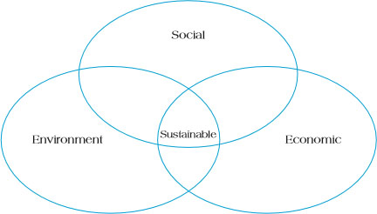
Sustainability
Sustainable development involves efforts to promote harmony among human beings and between humanity and nature.
Sustainability involves efforts to promote the triple bottom line of social sustainability, environmental sustainability, and economic sustainability.
Figure 5.12 The Triple Bottom Line of Sustainability

Slide 37
Sustainability Concepts
Sustainability is about:
Harmonizing the triple bottom line
Integrating short-term and long-term
Consuming income, not capital
Including local and global perspectives
Values and ethics
Transparency and accountability
Stakeholder participation
Risk reduction
Waste elimination

Slide 38
Sustainable Project Management Practices
Project management sustainable practices include:
Engaging in sustainable projects that will not cause harm to the planet or its inhabitants
Employing sustainable practices while undertaking the projects themselves
Developing sustainable supplier practices
Emphasizing sustainability in project design
Sustainable project management practices require organizations to pay attention to all aspects of the project life cycle from conceptualization through termination.

Slide 39
Summary (1 of 2)
Understand the importance of scope management for project success.
Understand how conceptual development serves as a critical first stage in scope management.
Identify the steps in developing the scope statement.
Identify the elements in the work authorization phase of scope development.

Slide 40
Summary (2 of 2)
Identify the various types of information available for scope reporting.
Demonstrate how control systems and configuration management relate to scope development.
Discuss why effective scope management includes a project closeout stage.
Understand how project practices can support the critical goal of sustainability.

Slide 41
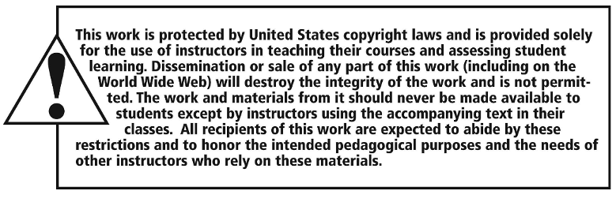
Copyright

